Slide 1
Actual Temperature Prediction
Using Machine Learning
TATA Steel Internship Project
Subhajit Palit

Slide 2
Business Problem
Accurate temperature prediction is critical in Basic Oxygen Furnace (BOF) steelmaking because it directly influences the quality of the final steel product, energy efficiency, and process stability, with poor temperature control leading to defects and increased rework.
Traditionally, operators in steel plants estimate endpoint temperatures manually based on experience and basic process measurements, which often leads to quality variations and inconsistent results.
To address this challenge, researchers and engineers are applying machine learning models to predict the actual temperature (ACT_TEMP) at key points in the BOF process using large historical datasets of process parameters and sensor readings. Advanced algorithms such as ensemble methods (e.g., XGBoost, LightGBM, CatBoost), random forests, support vector regression (SVR), and neural networks have been evaluated for predicting endpoint temperature with much higher accuracy than manual estimation.
These data-driven models can capture nonlinear relationships between process inputs (like hot metal composition, oxygen flow, and slag chemistry) and temperature, improving prediction accuracy often within tight error bands (e.g., within ±10-20 °C) compared to older approaches.
The objective of this project is therefore to develop and compare machine learning models that accurately predict ACT_TEMP in BOF steelmaking, reducing quality variations, lowering the need for rework, and enabling better process control

Slide 3
Dataset Overview
Basic Oxygen Furnace (BOF) process dataset
17,000+ heats, 50+ process variables
Includes chemical composition, material inputs, temperatures
Target Variable: ACT_TEMP (Actual Temperature)

Slide 4
Data Preprocessing Strategy
Removed invalid ACT_TEMP values (sensor error = 0)
Handled missing values using mean imputation
Dropped CASTNO and timestamp columns
Ensured data consistency using domain knowledge

Slide 5
Data Loading & Cleaning (Code)
import pandas as pd
df = pd.read_excel("BOF_Data1.xlsx")
# Remove invalid temperature values
df = df[df["ACT_TEMP"] > 1000]
# Drop non-informative columns
df.drop(columns=["CASTNO", "TAP_END"], inplace=True)
# Handle missing values
df.fillna(df.mean(), inplace=True)

Slide 6
Feature Selection & Split (Code)
from sklearn.model_selection import train_test_split
X = df.drop(columns=["ACT_TEMP"])
y = df["ACT_TEMP"]
X_train, X_test, y_train, y_test = train_test_split(
X, y, test_size=0.2, random_state=42
)

Slide 7
Model Training – Random Forest (Code)
from sklearn.ensemble import RandomForestRegressor
rf = RandomForestRegressor(
n_estimators=500,
max_depth=20,
random_state=42,
n_jobs=-1
)
rf.fit(X_train, y_train)
y_pred = rf.predict(X_test)

Slide 8
Model Evaluation
Metrics used: MAE, RMSE, R² Score
Random Forest significantly outperformed Linear Regression
Model captured non-linear industrial relationships effectively

Slide 9
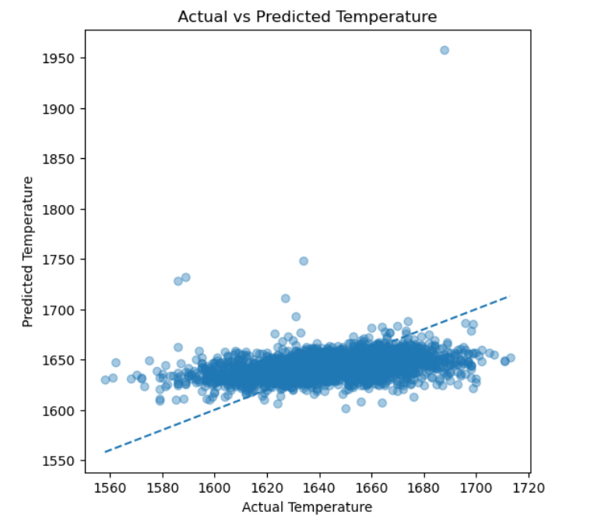
Actual vs Predicted Temperature

Slide 10
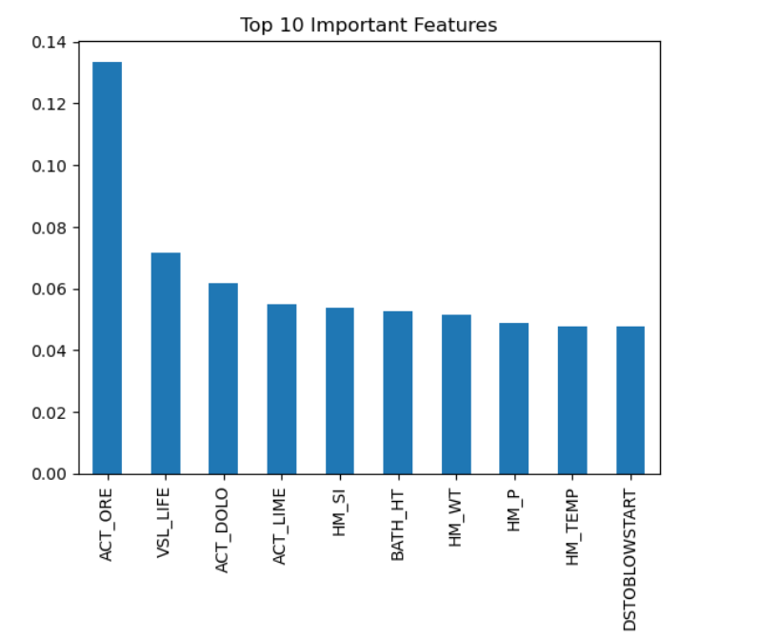
Key Influencing Process Parameters

Slide 11
Sample Prediction Outcome
Predicted Temperature: 1638.5 °C
Actual Temperature: 1626 °C
Prediction error is within acceptable industrial tolerance

Slide 12
Conclusion & Business Value
ML models can reliably predict BOF temperature
Random Forest suitable for complex steelmaking data
Supports process optimization and quality consistency at TATA Steel

Slide 13
Future Enhancements
Use advanced models like XGBoost / LightGBM
Real-time integration with BOF automation systems
Deployment as decision-support dashboard
Continuous learning using live plant data

